Slide 1
Doctor Paw’s Vet App
TEAM 1
Done by: Hanan Kwok, Pitsinee Phejlada, Farnoosh Sharifian Esfahani, Laura Roesler, Shyam Patel, Priyanka Gottipati, Wendell J.

Slide 2
Dr. Paw’s Vet App
Mobile application designed for a Vet who wants his clients to :-
Sign Up and Login
Receive Pop Up reminders on scheduling appointments for pet procedures.
Upcoming Shots
Required time-dependent medication
Be able to schedule appointments using app itself
Edit & Delete existing
Message vet about any issues or concerns

Slide 3
User Stories
Requirement 1: Login
Requirement 2: Sign Up
Requirement 3: Pet Profile
User needs to be able to view list of his/her pets in the system
View pets information accordingly
Requirement 4: Appointments
Be able to schedule appointments
Edit or delete created appointments
Requirement 5: Reminders
Requirement 6: Messages

Slide 4
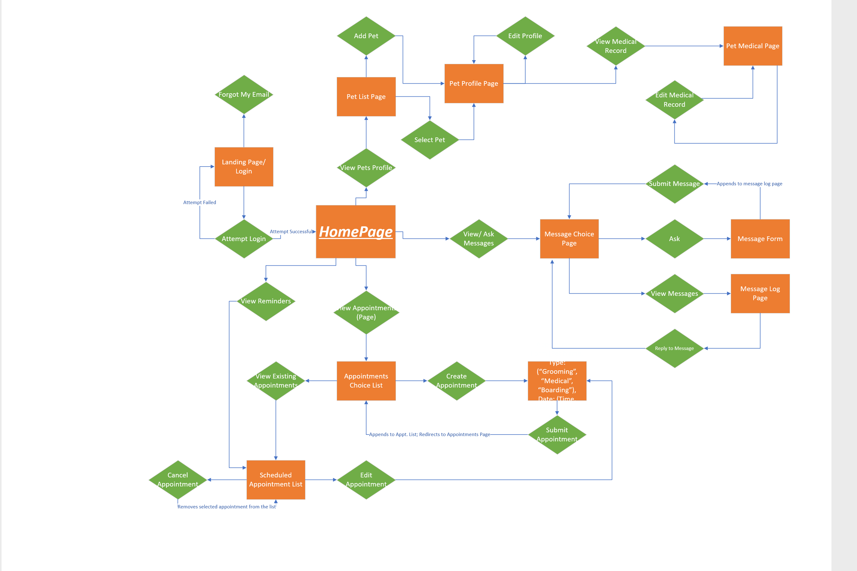
Flow Chart

Slide 5
Developer Tools
Android Studio
MySQL
Version Control (GitHub)

Slide 6
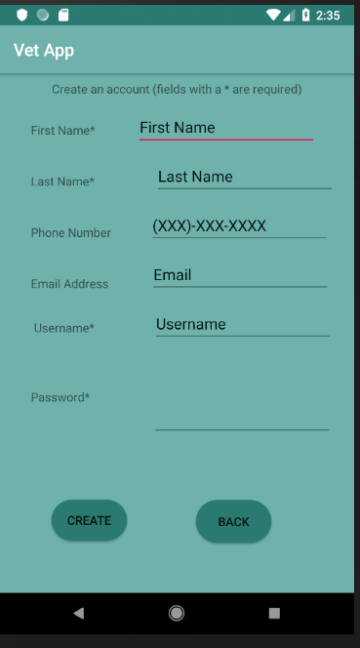
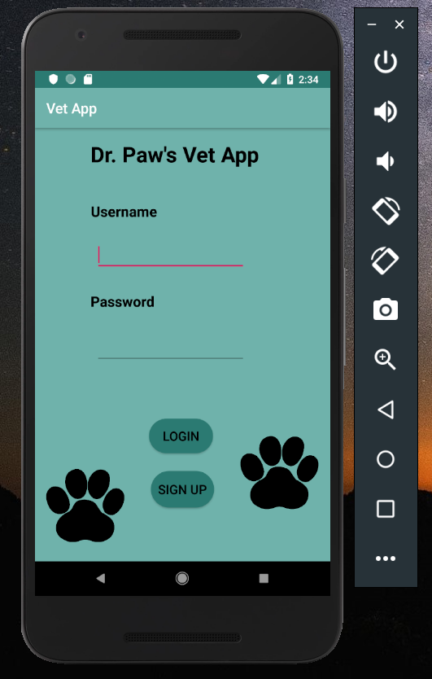
Login & Sign Up
Transferable & Convenient

Slide 7
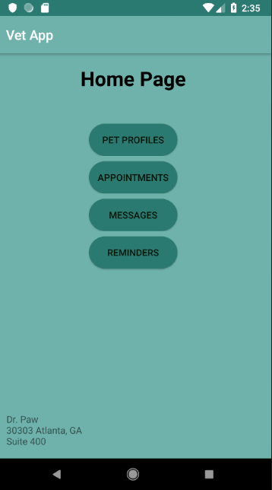

Home Page
Navigates to Other pages

Slide 8
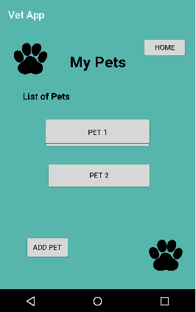
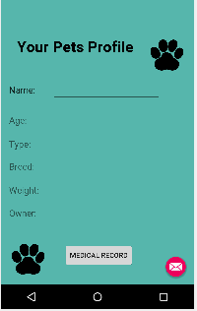
Pet Profiles

Slide 9
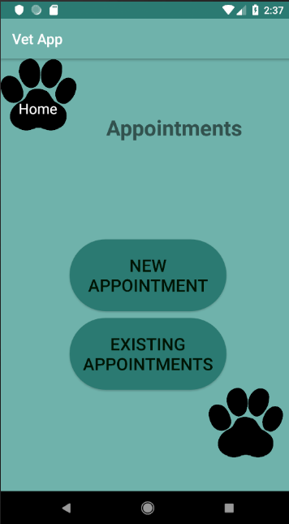
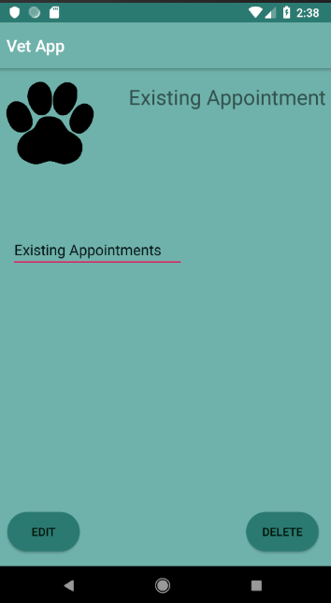
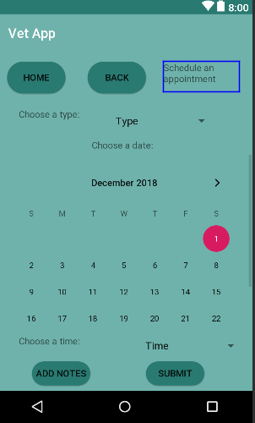
Appointments

Slide 10
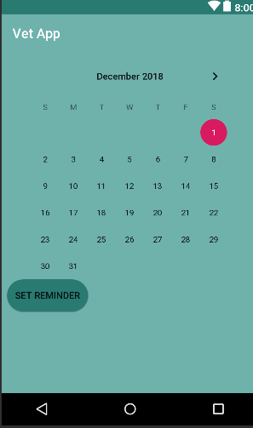
Reminders
Have an alert dialog pop up on the day of the appointment that displays whether its a medical, boarding or grooming appointment
POP UP reminders to schedule needed appointments.

Slide 11
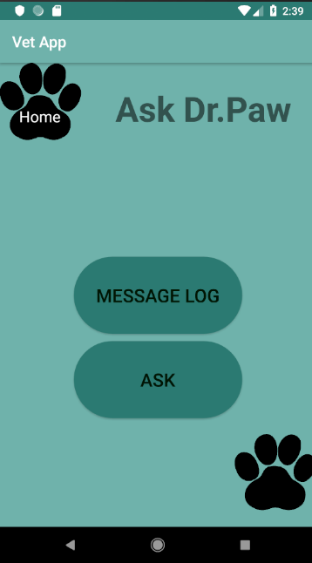
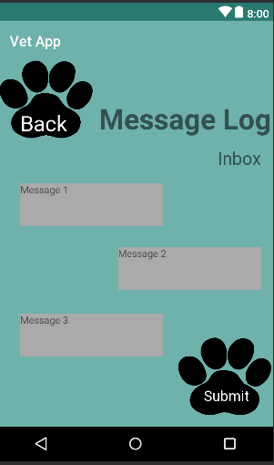
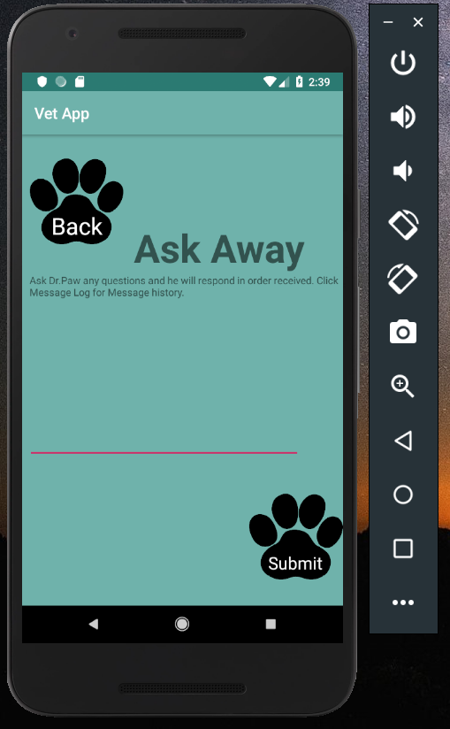
Messages

Slide 12
Some Challenges Faced
Doing a project with a big group – Communication Issues
Being able to view our progress in real time
Agreeing on a “standard” for the tools used in the project

